Slide 1

By:
Sharat Babu Jami

Slide 2
OLA was founded in January, 2011, by Two IIT Bombay Alumni
Bhavish Aggarwal (CEO) & Ankit Bhati (CTO – Chief Technical
Officer) and presently based in Bangalore.
Name has been derived from a spanish word – Hola means Hello.
OLA ensures convenient, transparent and quick service
Customers can access OLA on the web, through the mobile app
or through the customer service centre.

Slide 3
What do it do.?
Ola provides different types of service, ranging from economic to luxury travel.
The cabs are reserved through a mobile app and the service accepts both cash and cashless payments with Ola money.
It claims to clock an average of more than 150,000 bookings per day and commands 60% of the market share in India.
Revenue is approximate to $110mn(Rs.758 cr).

Slide 4
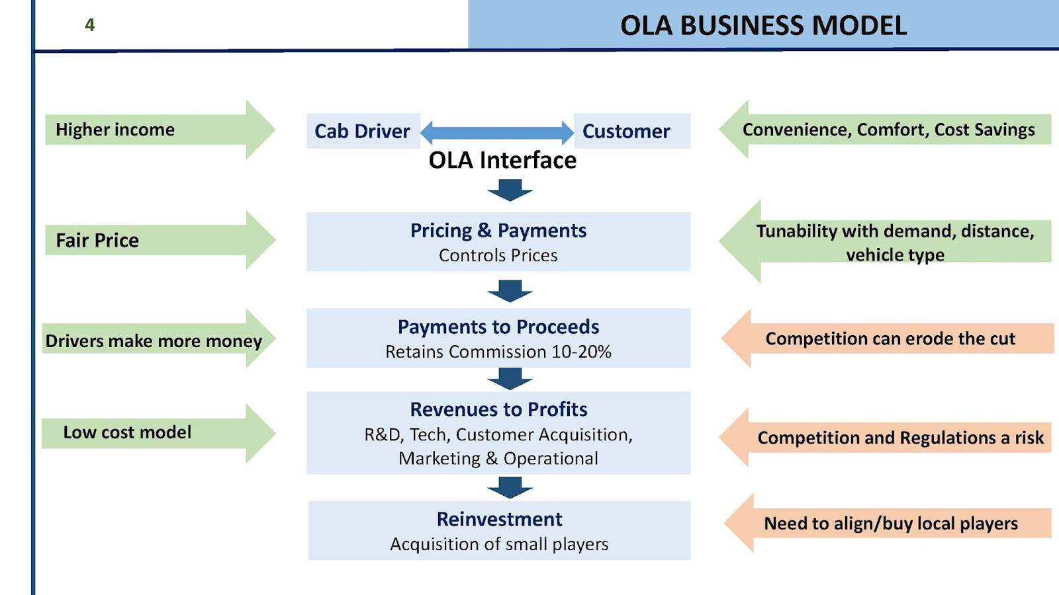
Functions
HR
IT
Administration
Business Development
Customer Service

Slide 5
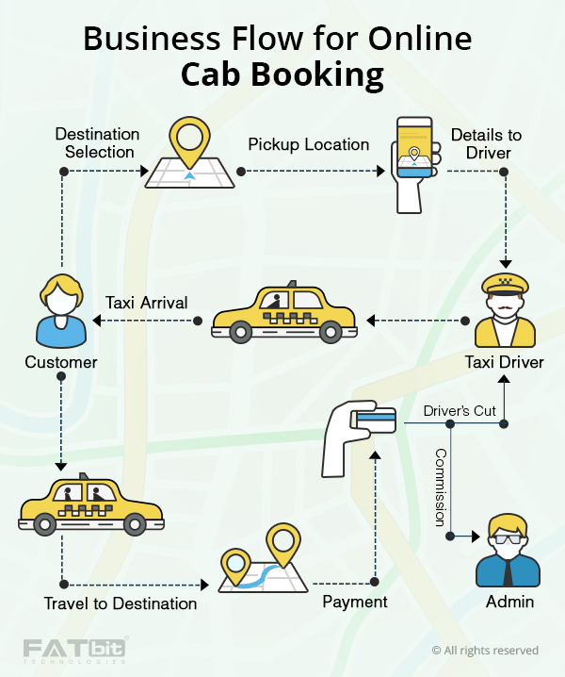
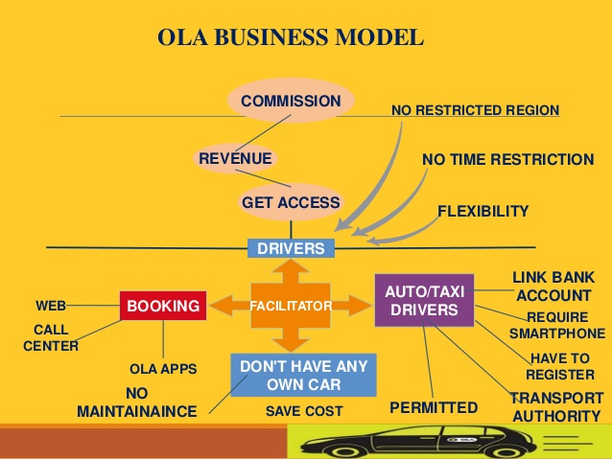

Slide 6
Revenue & Cost
Percent Commission from Trip
Ola Money Wallet
Corporate Tie Ups/Event Tie Ups
Vehicle On-Boarding fee
In-Cab Advertisements
Fleet Leasing
Car Type
Peak Time Charges
Administration
Business Development
Advertisement cost

Slide 7
Important KPI’s and Metrics
Satisfaction rate
Revenue per day/month
No.of type wise cabs/auto booked
City wise revenue
Post process services
Matching demand and capacity efficiently
Chase strategy – Matching capacity to demand
Level strategy – Maintaining capacity that serves the maximum demand
Demand management – Influencing the demand profile to smooth the load on the resources

Slide 8
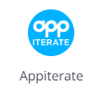


Analysis Implemented in
Appiterate is a mobile marketing automation platform for native mobile applications.
Yahoo! Web Analytics is an enterprise-level, highly customizable web analytics system to help business websites increase visitor satisfaction and sales, get new insights in online customers and reduce marketing costs.
Google Analytics Solutions offer free and enterprise analytics tools to measure website, app, digital and offline data to gain customer insights.

